Slide 1

Bayesian Learning and Monte Carlo Simulation
Project: Boston Housing Dataset
Politecnico di Milano
Authors: Felipe Azank dos Santos, Gabriel Speranza Pastorello, Giacomo Savazzi
Advisor: Prof. Federico Bassetti
Co-advisors: Alessandro Carminati

Slide 2
Introduction
Goal: perform a regression analysis on the Boston Housing Dataset to predict the median value of owner-occupied homes (MEDV)
Features: 13 features + target included in the dataset:
Feature | Description
CRIM | per capita crime rate by town
ZN | proportion of residential land zoned for lots over 25,000 sq.ft.
INDUS | proportion of non-retail business acres per town
CHAS | Charles River dummy variable (1 or 0)
NOX | nitric oxides concentration (parts per 10 million)
RM | average number of rooms per dwelling
AGE | proportion of owner-occupied units built prior to 1940
Feature | Description
DIS | weighted distances to five Boston employment centres
RAD | index of accessibility to radial highways
TAX | full-value property tax rate per $10,000
PTRATIO | pupil-teacher ratio by town
B | 1000(Bk -0.63)² where Bk is the proportion of blacks by town
LSTAT | % of lower status of the population
MEDV | Median value of owner-occupied homes (in $1000’s)

Slide 3
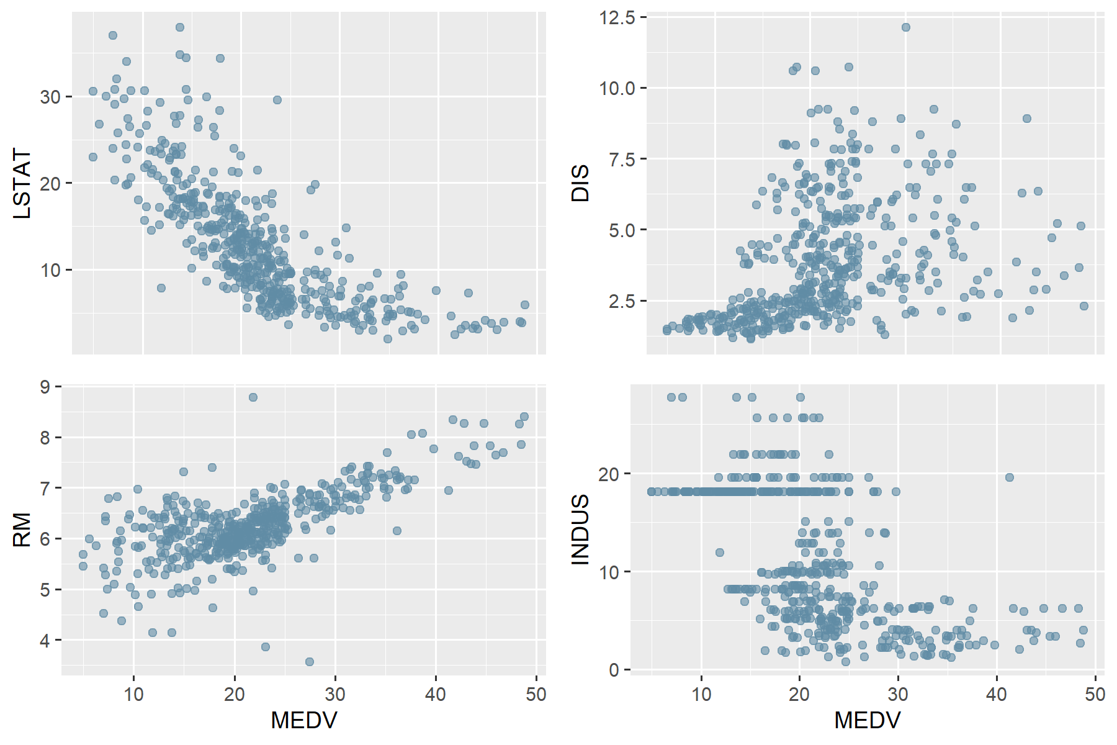
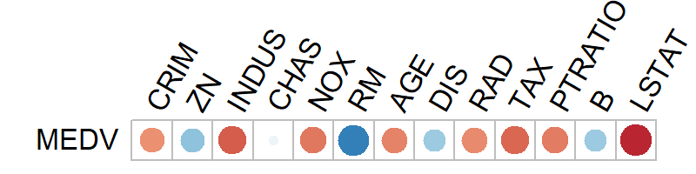

Description of the data
MEDV value has been set to a maximum of 50 [1], with multiple instances of this exact value in the dataset
Considered outliers and will not help in prediction, so they were removed
Total number of samples decreased from 506 to 490
Fig. 1: Linear correlation plot between the features and MEDV
Fig. 2: Scatter plots of LSTAT (upper left), DIS (upper right), RM (lower left) and TAX (lower right) in relation to target variable MEDV.
[1] https://www.kaggle.com/code/prasadperera/the-boston-housing-dataset
3

Slide 4
Model specification
Standard Bayesian Regression
g-prior
Jeffreys-Zellner-Siow (JZS) prior
Bayesian Information Criterion (BIC)
Just Another Gibbs Sampler (JAGS) Spike and Slab
Median Probability (MP)
Highest Probability Density (HPD)

Slide 5

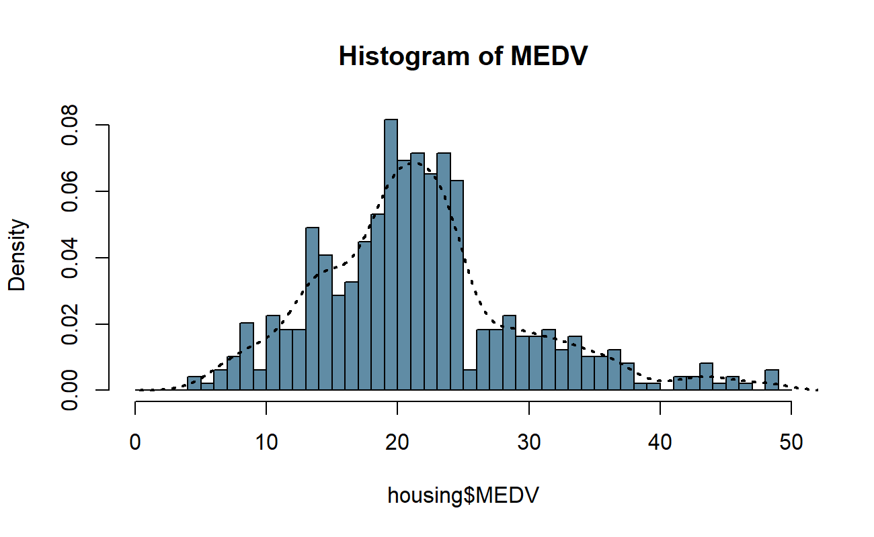
Standard Bayesian Regression: g-prior
Assigns a normal distribution prior to the regression coefficients:
α = g value
Small g = strong belief in the prior
Big g = not considerable belief in the prior
g values tried: 100, 50, 1
Without any major changes, α is then set to 1
Fig. 3: Histogram for target MEDV
5

Slide 6
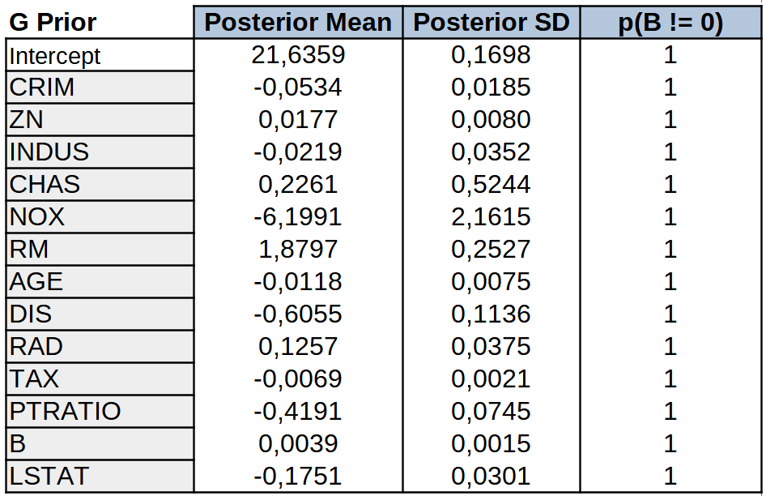
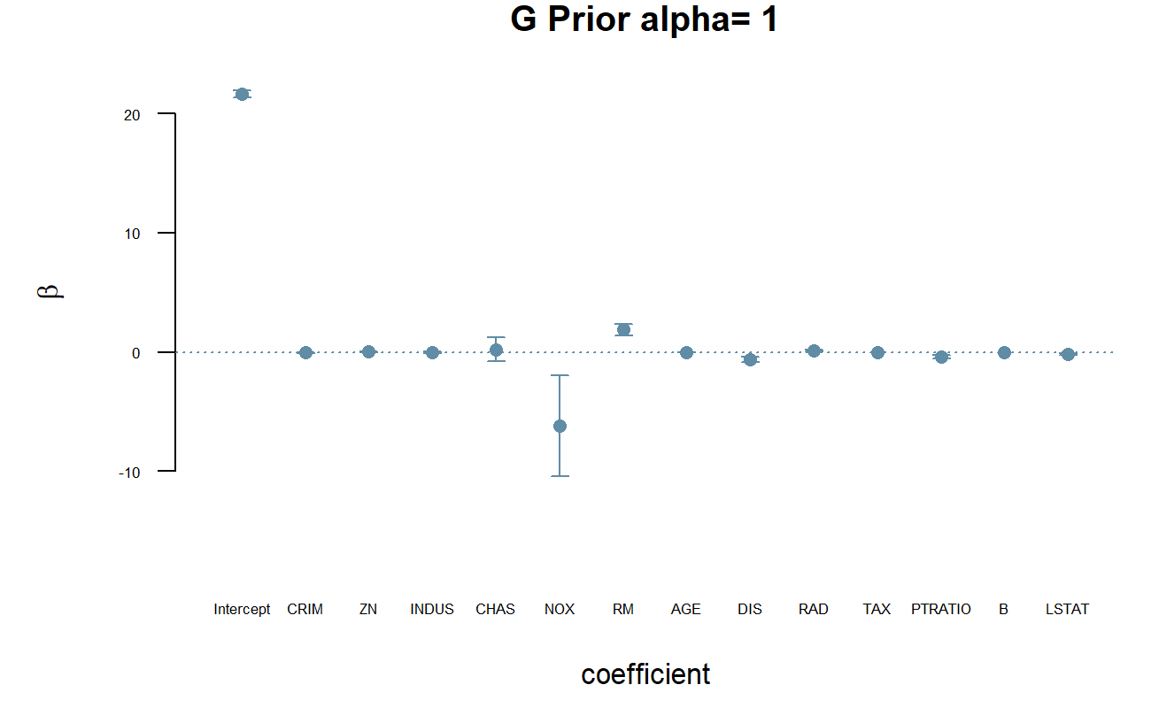
Standard Bayesian Regression: g-prior
The following values for the coefficients are obtained:
Fig. 4: g-prior posterior distribution of coefficients
Fig. 5: Parameters mean values and confidence intervals with g-prior
6

Slide 7
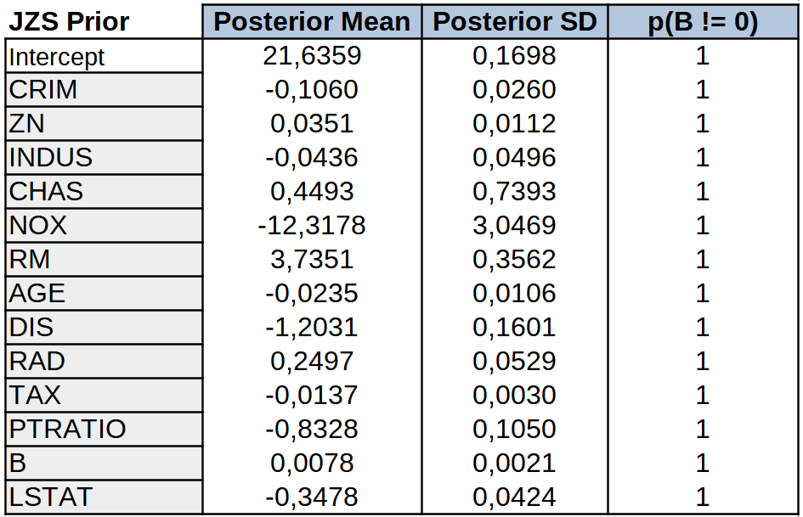
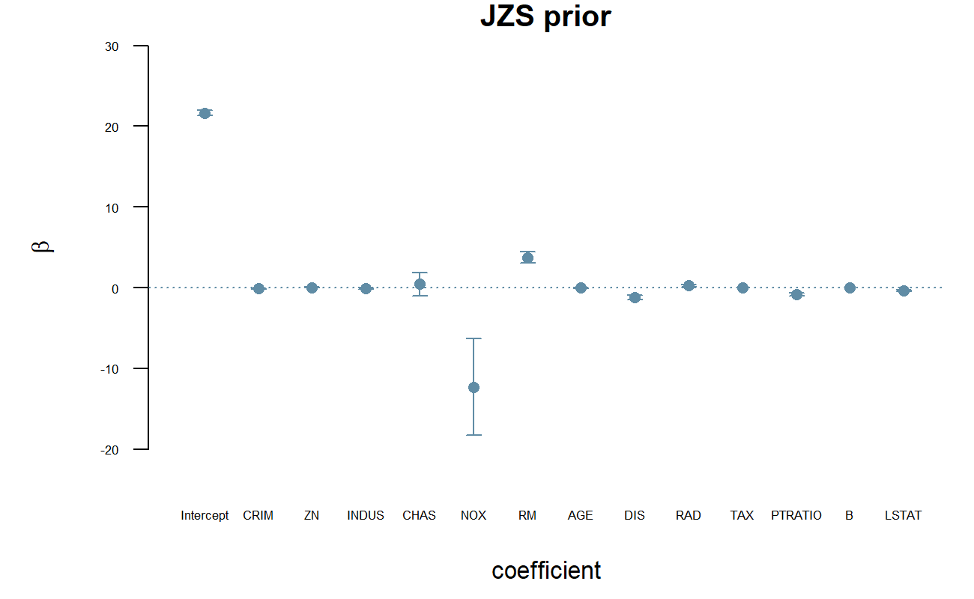
Standard Bayesian Regression: JZS prior
Jeffreys prior on σ and the Zellner-Siow prior on the coefficients
It is a mixture of the g-prior and does not introduce additional information but rather reflects a conservative belief about the coefficients’ distribution.
Fig. 6: JZS posterior distribution of coefficients
Fig. 7: Parameters mean values and confidence intervals with JZS prior
7

Slide 8
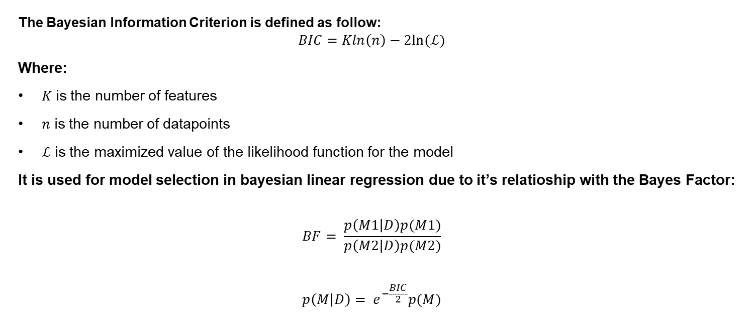
Bayesian Information Criterion (BIC)
The Bayesian Information Criterion is defined as follow:
$$BIC=Kln\left(n\right)−2ln⁡(ℒ)$$
Where:
$K$is the number of features
$n$ is the number of datapoints
$ℒ$ is the maximized value of the likelihood function for the model
It is used for model selection in bayesian linear regression due to it’s relatioship with the Bayes Factor:
$$BF= \frac{p\left(M1 | D\right)p(M1)}{p\left(M2 | D\right)p(M2)}$$
$$p\left(M | D\right)= e^{−\frac{BIC}{2}}p(M)$$
8

Slide 9
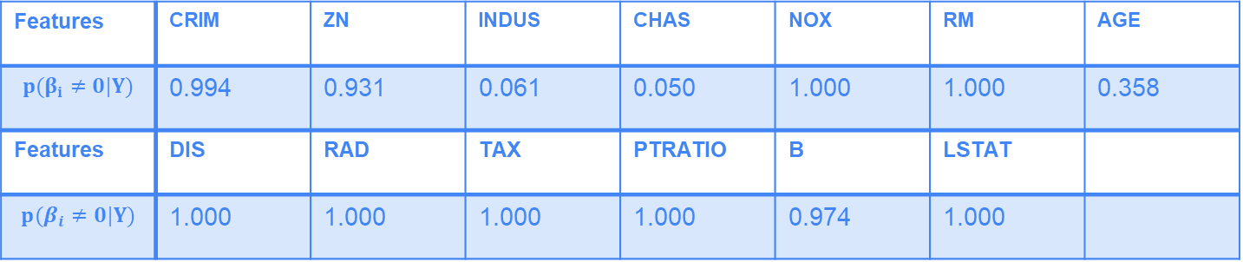
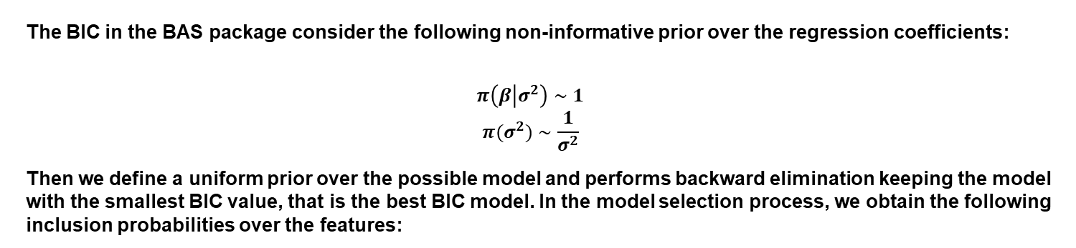
Bayesian Information Criterion (BIC)
The BIC in the BAS package consider the following non-informative prior over the regression coefficients:
$$π\left(β | σ^{2}\right)∼1$$
$$π(σ^{2})∼\frac{1}{σ^{2}}$$
Then we define a uniform prior over the possible model and performs backward elimination keeping the model with the smallest BIC value, that is the best BIC model. In the model selection process, we obtain the following inclusion probabilities over the features:
Features | CRIM | ZN | INDUS | CHAS | NOX | RM | AGE
$$p(β_{i}≠0|Y)$$ | 0.994 | 0.931 | 0.061 | 0.050 | 1.000 | 1.000 | 0.358
Features | DIS | RAD | TAX | PTRATIO | B | LSTAT
$$p(β_{i}≠0|Y)$$ | 1.000 | 1.000 | 1.000 | 1.000 | 0.974 | 1.000
9

Slide 10
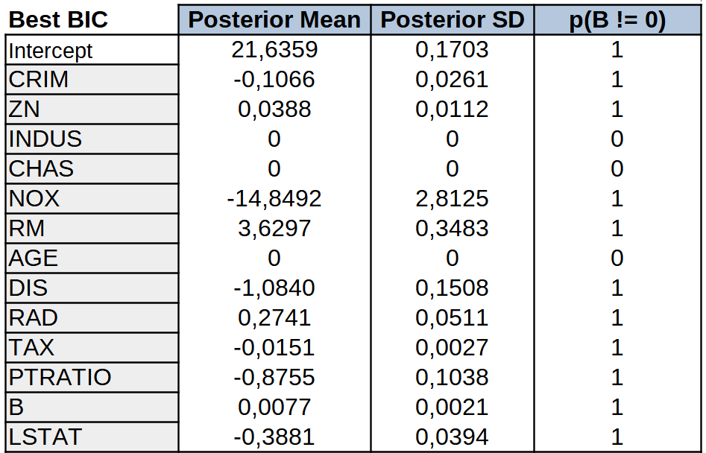
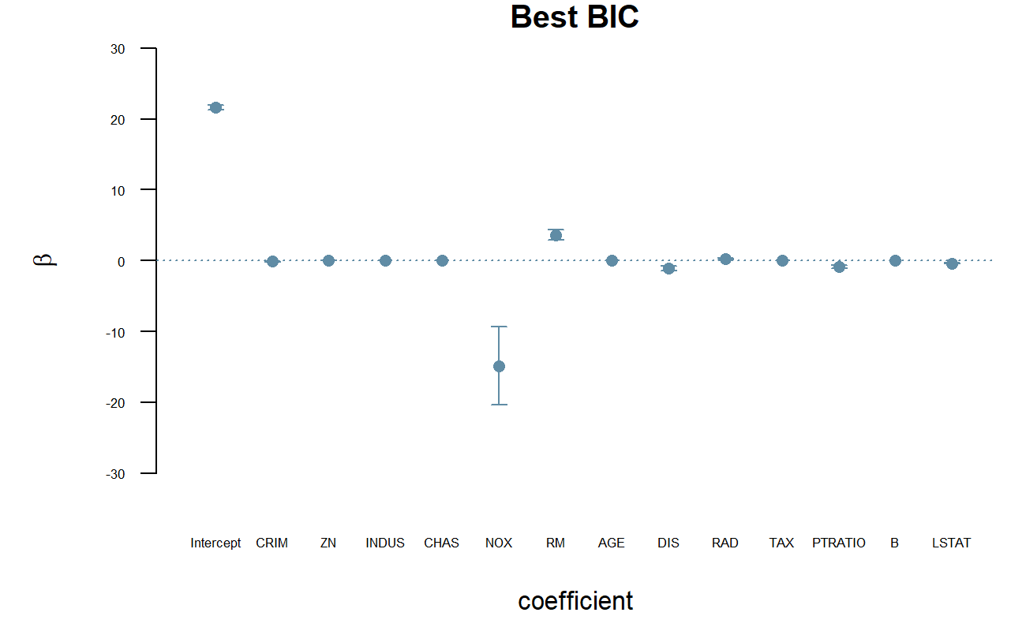
Bayesian Information Criterion (BIC)
Then we consider the best BIC model and obtain the following value for the regression coefficients:
Fig. 8: BIC posterior distribution of coefficients
Fig. 9: Parameters mean values and confidence intervals with BIC
10

Slide 11
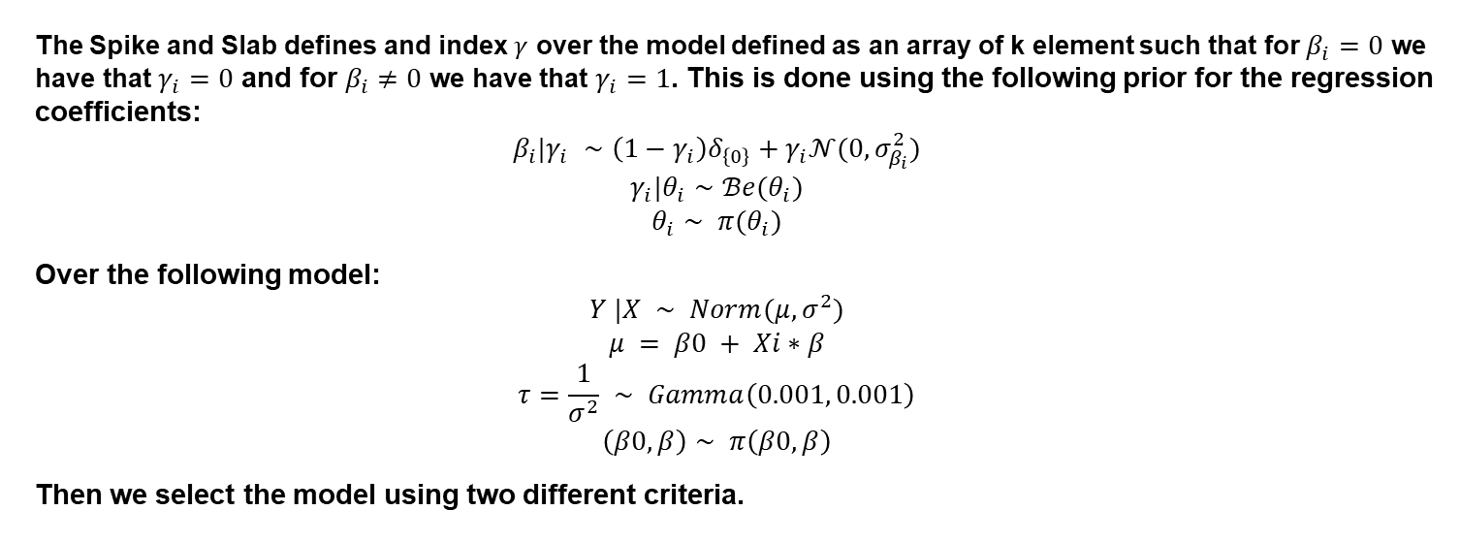
Just Another Gibbs Sampler (JAGS) Spike and Slab
The Spike and Slab defines and index $γ$ over the model defined as an array of k element such that for $β_{i}=0$ we have that $γ_{i}=0$ and for $β_{i}≠0$ we have that $γ_{i}=1$. This is done using the following prior for the regression coefficients:
$$β_{i}|γ_{i} ∼\left(1−γ_{i}\right)δ_{\left\{0\right\}}+γ_{i}𝒩(0,σ_{β_{i}}^{2})$$
$$γ_{i}|θ_{i}∼ℬe(θ_{i})$$
$$θ_{i}∼ π(θ_{i})$$
Over the following model:
$$Y |X ∼ Norm(μ,σ^{2})$$
$$μ = β0 + Xi∗β$$
$$τ=\frac{1}{σ^{2}} ∼ Gamma\left(0.001, 0.001\right)$$
$$\left(β0, β\right)∼ π\left(β0, β\right)$$
Then we select the model using two different criteria.
11

Slide 12
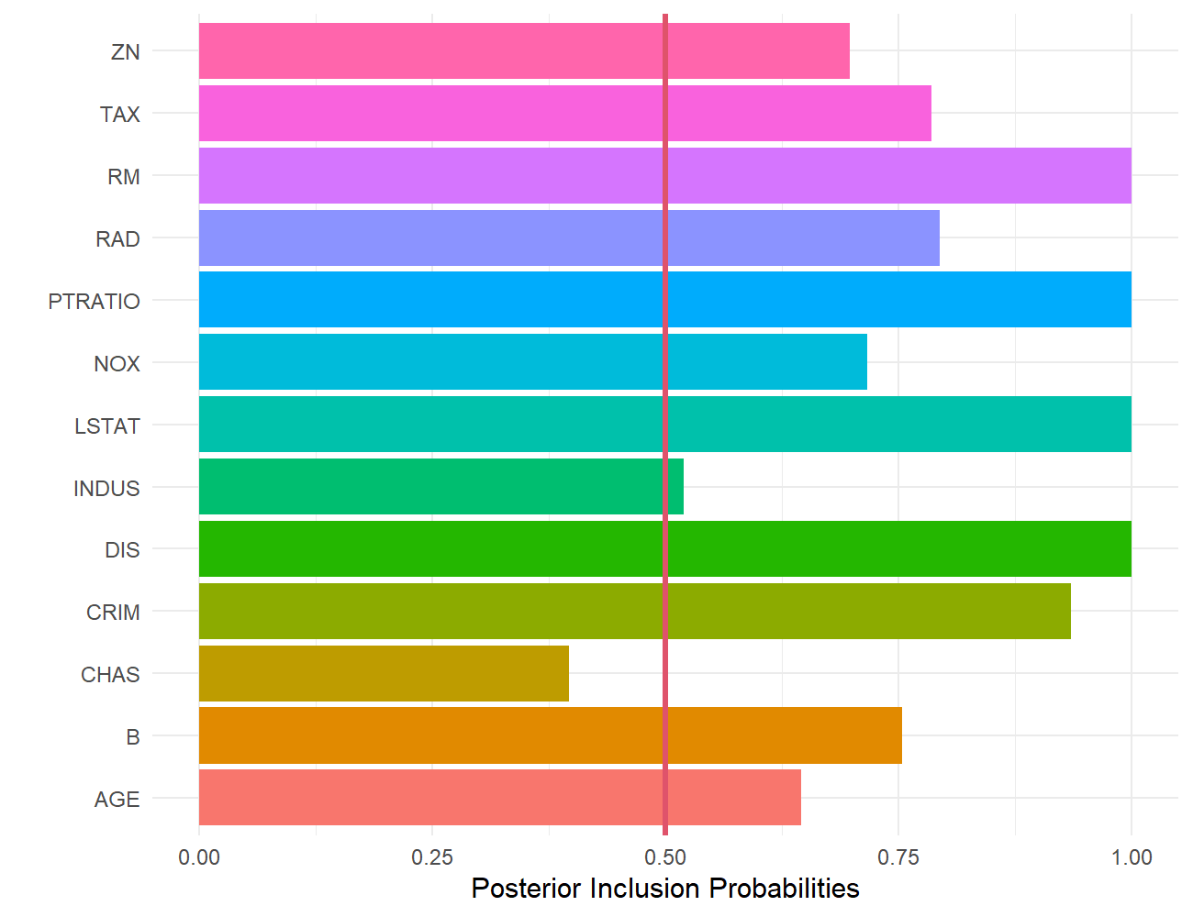
JAGS Spike and Slab: Median Probability Model
In the Median Probability model, we consider the posterior of the inclusion variable and select the features that have probability higher than 0.5 to be included.
In this case only the CHAS feature is excluded from the model as all the other features have inclusion probability higher than 0.5
Fig. 10: Histogram of the g values used to determine the selected features
12

Slide 13
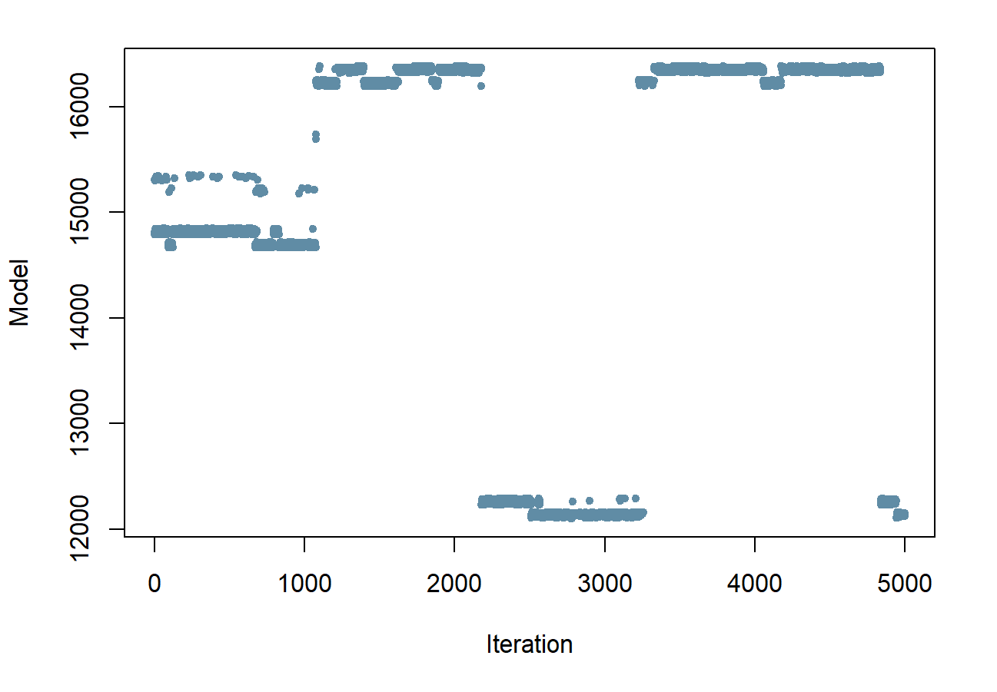
JAGS Spike and Slab: Highest Posterior Density Model
In the Highest Posterior Density model, we select the model that was visited more times in the MCMC generated by JAGS.
The models are indexed based on the features included, so from the index of the model we can extract what features were excluded.
In this case the features excluded were INDUS and CHAS.
Fig. 11: Visited Models JAGS approach
13

Slide 14
Prediction Analysis
Train-test split with Shuffling
70/30 proportion
Removing bias
147 test samples
Regression Metrics
RMSE
MAE
MAPE
Performance Comparison

Slide 15
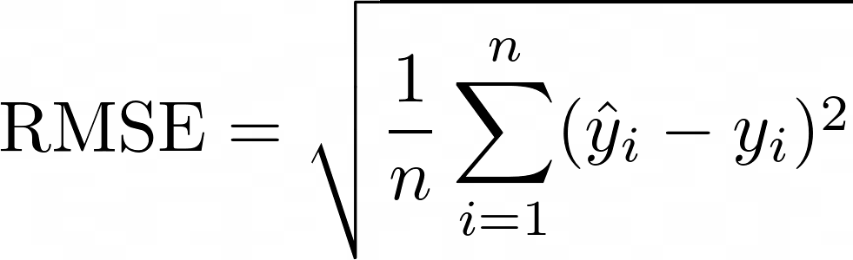
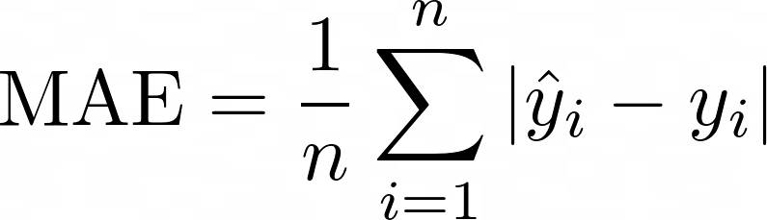
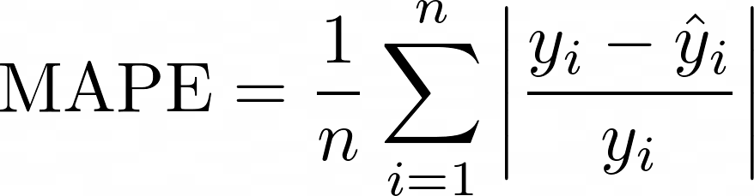
Regression Metrics
Root Mean Squared Error (RMSE)
Easy interpretability (same unit as the target)
Large errors penalization
Mean Absolute Error (MAE)
Overall performance (equal penalization)
Mean Absolute Percentage Error (MAPE)
Most intuitive (eliminates magnitude)
Ideal for low range target values
15

Slide 16
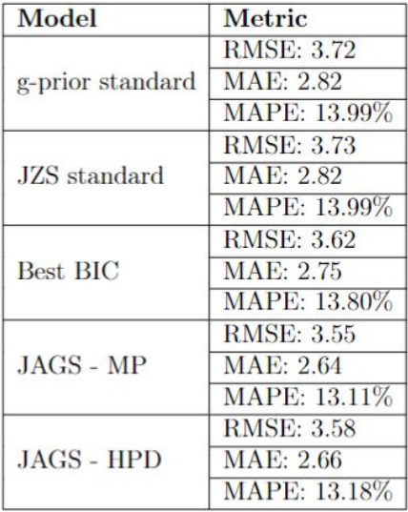
Prediction Analysis – Performance Comparison
Just like the posterior, the predictive distribution of the standard Bayesian Regression showed similar results, proving once again that the model was quite robust and indifferent to the priors.
BIC approach was successful in improving both performance and complexity, proving to be a "go to" approach when dealing with simple regression problems.
Both MCMC model selection techniques (MP & HPD) generated a better performance (this could be a sign of overfitting since the models are more complex).
Fig. 12: Comparison of the models’ performances
​
16

Slide 17
Conclusions
All feature selection approaches dropped CHAS feature. Proving that, for our analysis, the CHAS column proved to be useless.
The Bayesian Regression Analysis proved to be relativelly sucessfull, corroborating our choice to use the Normal Linear Regression.
The project was extremelly useful in reviewing the main points talked in the class and lab sessions.

Slide 18

Thank you!
Felipe A. dos Santos (10919711)
Gabriel S. Pastorello (10946365)
Giacomo Savazzi (10675184)

